Slide 1
L11. Influential Diagram

Slide 2







Introduction
Bayesian Network + Decision node + Utility node = Decision network (Influential Diagram)
make rational decisions based on a probabilistic model and utility function
Treat ?
$$T$$
Disease ?
$$D$$
$$U$$
$${ O}^{1}$$
$${ O}^{2}$$
$${ O}^{3}$$
Results from diagnostic tests
A chance node corresponds to a random variable
A decision node corresponds to each decision to be made
A utility node corresponds to an additive utility component

Slide 3

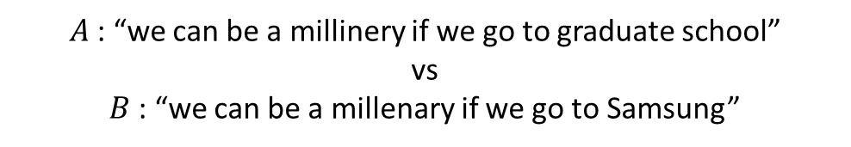
Utility theory
How to compare the plausibility of different statements?
$A$: “we can be a millinery if we go to graduate school”
vs
$B$: “we can be a millenary if we go to Samsung”
If you believe $A$more than $B$, you can write $A≻B$
If you believe $B$ more than $A$, you can write $A≺B$
If you have the same belief, you can write $A\sim B$

Slide 4
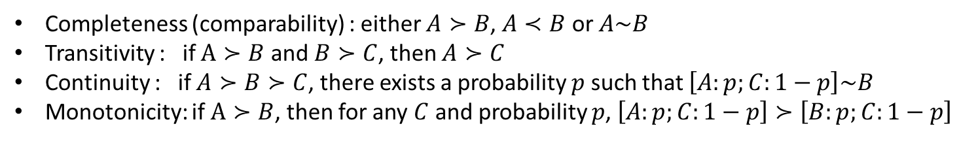
Constraints on Rational Preference
Assumptions about relationships of $≻$ and $\sim$
Completeness (comparability) : either $A≻B$, $A≺B$ or $A\sim B$
Transitivity : if $A≻B$ and $B≻C$, then $A≻C$
Continuity : if $A≻B≻C$, there exists a probability $p$ such that $\left[A:p;C:1−p\right]\sim B$
Monotonicity: if $A≻B$, then for any $C$ and probability $p$, $\left[A:p;C:1−p\right]≻\left[B:p;C:1−p\right]$
The degree of belief can be represented by a real-valued function:
$P\left(A\right)>P\left(B\right)$ if and only if $A≻B$
$P\left(A\right)=P\left(B\right)$ if and only if $A\sim B$

Slide 5
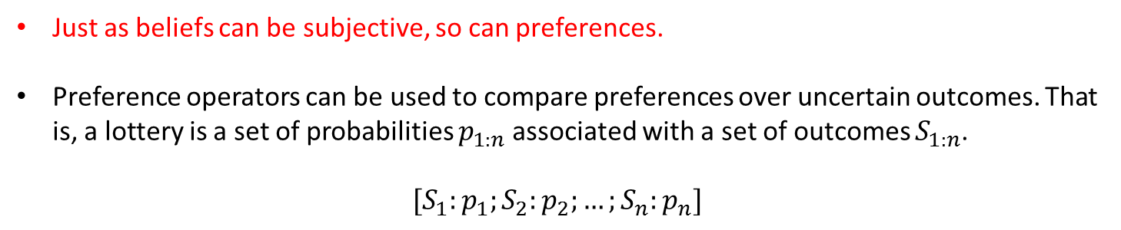
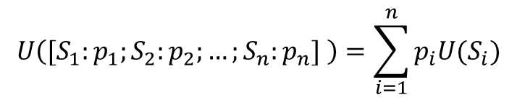
Utility functions
Just as beliefs can be subjective, so can preferences.
Preference operators can be used to compare preferences over uncertain outcomes. That is, a lottery is a set of probabilities $p_{1:n}$associated with a set of outcomes $S_{1:n}$.
$$[S_{1}:p_{1};S_{2}:p_{2};…;S_{n}:p_{n}]$$
The utility of a lottery is given by
$$U\left([S_{1}:p_{1};S_{2}:p_{2};…;S_{n}:p_{n}] \right)=\sum_{i=1}^{n}{p_{i}U(S_{i})}$$

Slide 6



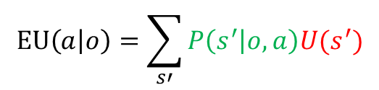
Maximum Expected Utility Principle
Reach rational decisions with imperfect knowledge of the state of the world.
Expected utility of taking action $a$ given that we observe $o$ and take action $a$:
Probabilistic model
Utility function
$$P(s^{′}|o,a)$$
$$U(s^{′})$$
$$EU\left(a | o\right)=\sum_{s′}{P\left(s^{′} | o,a\right)U(s^{′})}$$
The principle of maximum expected utility : a rational agent should choose the action that maximizes expected utility:
$$a^{∗}=\underset{a}{argmax}{EU\left(a | o\right)}$$

Slide 7
Utility of Money
Monetary values are often used to infer utility function.
For example, cost of property and human loss damage caused by natural disasters
It is well known that the relationship between utility and money is not linear as shown below
Utility
Utility
Money
Money
A: Wining 1$ with a probability 1 vs B: Wining 100$ with a probability 0.01
Risk averse : Preference for A (Utility function is concave)
Risk neutral : There is no difference between A and B (Utility function is a linear)
Risk seeking : Preference for B (Utility function is convex)

Slide 8


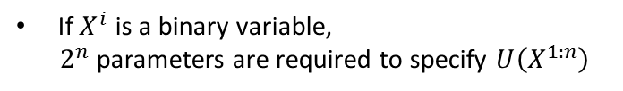

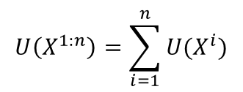









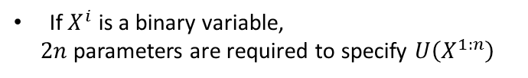



Multiple Variable Utility Function
$$X^{1}$$
$$⋯$$
$$X^{i}$$
$$⋯$$
$$X^{n}$$
$$X^{1}$$
$$⋯$$
$$X^{i}$$
$$⋯$$
$$X^{n}$$
Assumption:
Sum of single-variable utility function
$$U$$
$$U^{1}$$
$$U^{i}$$
$$U^{n}$$
$$U\left(X^{1:n}\right)$$
$$U\left(X^{1:n}\right)=\sum_{i=1}^{n}{U(X^{i}})$$
If $X^{i}$ is a binary variable,
$2^{n}$ parameters are required to specify $U\left(X^{1:n}\right)$
If $X^{i}$ is a binary variable,
$2n$ parameters are required to specify $U\left(X^{1:n}\right)$
Different additive decomposition can be explicitly imposed on the network structure!

Slide 9








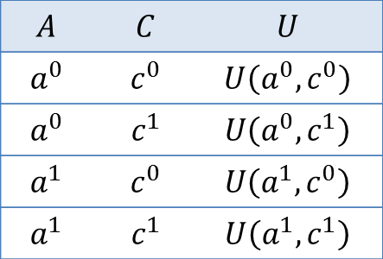

Multiple Variable Utility Function
Example :
Collison avoidance system
Close horizontally
Close
Vertically
Alarm
Alarm
Collison
$$A$$
$$C$$
$$H$$
$$V$$
$$A$$
$$U$$
$$U^{1}$$
$$U^{2}$$
$$A$$ | $$C$$ | $$U$$
$$a^{0}$$ | $$c^{0}$$ | $$U\left(a^{0},c^{0}\right)$$
$$a^{0}$$ | $$c^{1}$$ | $$U\left(a^{0},c^{1}\right)$$
$$a^{1}$$ | $$c^{0}$$ | $$U\left(a^{1},c^{0}\right)$$
$$a^{1}$$ | $$c^{1}$$ | $$U\left(a^{1},c^{1}\right)$$
Additive decomposition of utility function
$$U\left(h, v, a\right)=U^{1}\left(h,v\right)+U^{2}(a)$$

Slide 10








Decision Network
Bayesian Network + Decision node + Utility node = Decision network (Influential Diagram)
Treat ?
$$T$$ | $$D$$ | $$U(T,D)$$
$$0$$ | $$0$$ | $$0$$
$$0$$ | $$1$$ | $$−10$$
$$1$$ | $$0$$ | $$−1$$
$$1$$ | $$1$$ | $$−1$$
$$T$$
Disease ?
$$D$$
$$U$$
Conditional edge
$${ O}^{1}$$
$${ O}^{2}$$
$${ O}^{3}$$
Functional edge
Information edge (often omitted)
Results from diagnostic tests
A chance node corresponds to a random variable
A decision node corresponds to each decision to be made
A utility node corresponds to an additive utility component

Slide 11






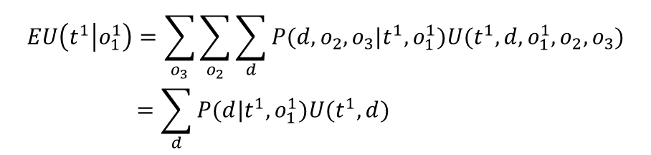
Decision Network
Assume we only have a single observation ${{ O}^{1}=1(=o}_{1}^{1})$ from test 1
Treat ?
$$T$$
Disease ?
$$D$$
$$U$$
$${ O}^{1}$$
$${ O}^{2}$$
$${ O}^{3}$$
Results from diagnostic tests
$$EU\left(t^{1} | o_{1}^{1}\right)=\sum_{o_{3}}{\sum_{o_{2}}{\sum_{d}{P(d,o_{2}, o_{3}|t^{1}, o_{1}^{1}})U(t^{1},d,o_{1}^{1}, o_{2}, o_{3})}}$$
$$=\sum_{d}{P(d|t^{1}, o_{1}^{1}})U(t^{1},d)$$
Can be computed using many inference methods
Compare $EU\left(t^{0} | o_{1}^{1}\right)$ and $EU\left(t^{1} | o_{1}^{1}\right)$ and chose the treatment that lead maximum EU

Slide 12

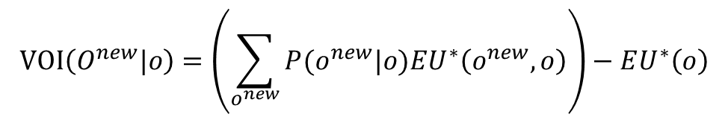
Value of Information
It may be beneficial to administer additional diagnostic tests to reduce the uncertainty about the decease. Then, how to choose a test type to be conducted?
Expected utility of optimal action given observation $o$ :
$$EU^{∗}\left(o\right)=\underset{a}{argmax}{EU(a|o)}$$
The value of information (VPI) about new variable $O^{new}$ (unobserved) given the current observation $o$ (observed):
$$VOI\left(O^{new}|o\right)=\left(\sum_{o^{new}}{P(o^{new}|o})EU^{∗}\left(o^{new},o\right)\right)−EU^{∗}\left(o\right)$$
The value of information about a variable is the increase in expected utility with the observation of that variable
VPI can only captures the increase in expected utility→ need to consider the cost associated with observing the new information

Slide 13
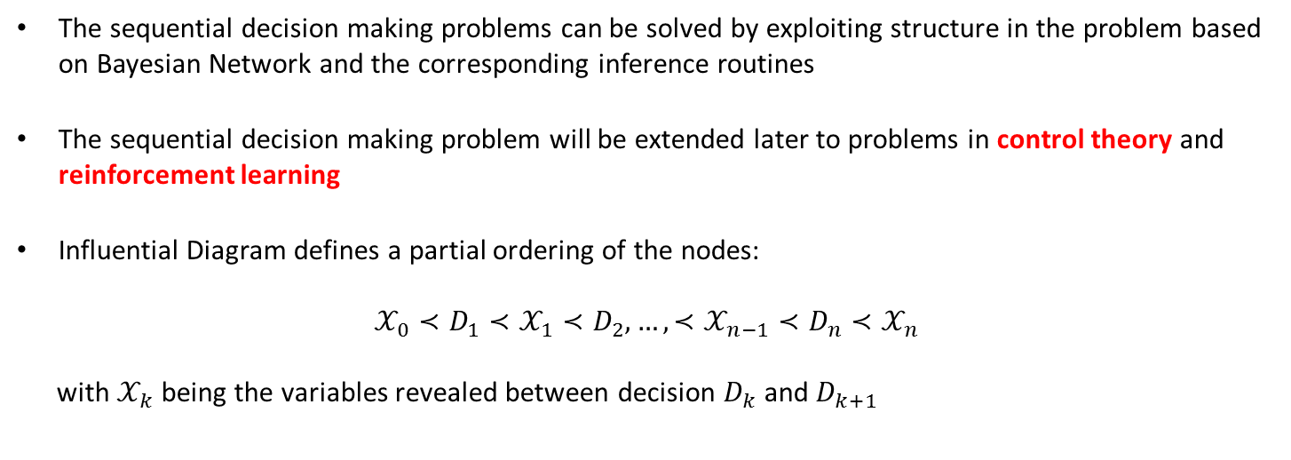
Sequential Decision Making : Partial Ordering
The sequential decision making problems can be solved by exploiting structure in the problem based on Bayesian Network and the corresponding inference routines
The sequential decision making problem will be extended later to problems in control theory and reinforcement learning
Influential Diagram defines a partial ordering of the nodes:
$$𝒳_{0}≺D_{1}≺𝒳_{1}≺D_{2},…,≺𝒳_{n−1}≺D_{n}≺𝒳_{n}$$
with $𝒳_{k}$ being the variables revealed between decision $D_{k}$ and $D_{k+1}$

Slide 14





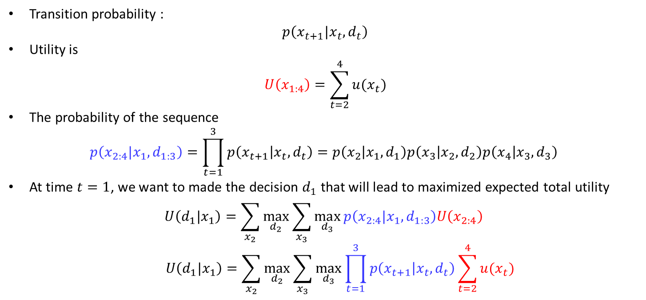






Sequential Decision Making : Partial Ordering
$$d_{1}$$
$${ d}_{2}$$
$${ d}_{3}$$
$${ d}_{4}$$
$${ x}_{1}$$
$${ x}_{2}$$
$${ x}_{3}$$
$${ x}_{4}$$
$$u_{2}$$
$$u_{3}$$
$$u_{4}$$
Transition probability :
$p\left(x_{t+1}|x_{t}, d_{t}\right)$
Utility is
$$U\left(x_{1:4}\right)=\sum_{t=2}^{4}{u(x_{t})}$$
The probability of the sequence
$$p\left(x_{2:4}|x_{1}, d_{1:3}\right)=\prod_{t=1}^{3}{p\left(x_{t+1} | x_{t},d_{t}\right)=p\left(x_{2} | x_{1},d_{1}\right)p\left(x_{3} | x_{2},d_{2}\right)p\left(x_{4} | x_{3},d_{3}\right)}$$
At time $t=1$, we want to made the decision $d_{1}$ that will lead to maximized expected total utility
$$U\left(d_{1}|x_{1}\right)=\sum_{x_{2}}^{ }{\max_{d_{2}}{\sum_{x_{3}}^{ }{\max_{d_{3}}{p\left(x_{2:4}|x_{1}, d_{1:3}\right)U\left(x_{2:4}\right)}}}}$$
$$U\left(d_{1}|x_{1}\right)=\sum_{x_{2}}^{ }{\max_{d_{2}}{\sum_{x_{3}}^{ }{\max_{d_{3}}{\prod_{t=1}^{3}{p\left(x_{t+1} | x_{t},d_{t}\right)}}}}}\sum_{t=2}^{4}{u(x_{t})}$$

Slide 15


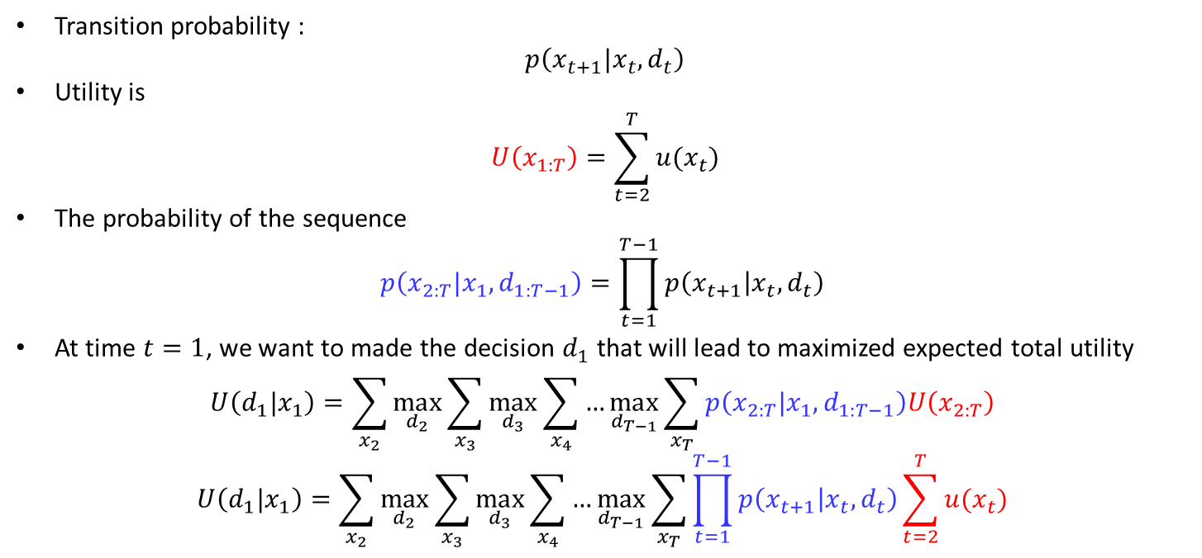


Sequential Decision Making : Partial Ordering
$$d_{1}$$
$${ d}_{2}$$
…
$${ d}_{3}$$
$${ d}_{T}$$
$${ x}_{1}$$
$${ x}_{2}$$
$${ x}_{3}$$
…
$${ x}_{T}$$
$$u_{2}$$
$$u_{3}$$
…
$$u_{T}$$
Transition probability :
$p\left(x_{t+1}|x_{t}, d_{t}\right)$
Utility is
$$U\left(x_{1:T}\right)=\sum_{t=2}^{T}{u(x_{t})}$$
The probability of the sequence
$$p\left(x_{2:T}|x_{1}, d_{1:T−1}\right)=\prod_{t=1}^{T−1}{p\left(x_{t+1} | x_{t},d_{t}\right)}$$
At time $t=1$, we want to made the decision $d_{1}$ that will lead to maximized expected total utility
$$U\left(d_{1}|x_{1}\right)=\sum_{x_{2}}^{ }{\max_{d_{2}}{\sum_{x_{3}}^{ }{\max_{d_{3}}{\sum_{x_{4}}^{ }{…\max_{d_{T−1}}{\sum_{x_{T}}^{ }{p\left(x_{2:T}|x_{1}, d_{1:T−1}\right)U\left(x_{2:T}\right)}}}}}}}$$
$$U\left(d_{1}|x_{1}\right)=\sum_{x_{2}}^{ }{\max_{d_{2}}{\sum_{x_{3}}^{ }{\max_{d_{3}}{\sum_{x_{4}}^{ }{…\max_{d_{T−1}}{\sum_{x_{T}}^{ }{\prod_{t=1}^{T−1}{p\left(x_{t+1} | x_{t},d_{t}\right)}\sum_{t=2}^{T}{u(x_{t})}}}}}}}}$$

Slide 16
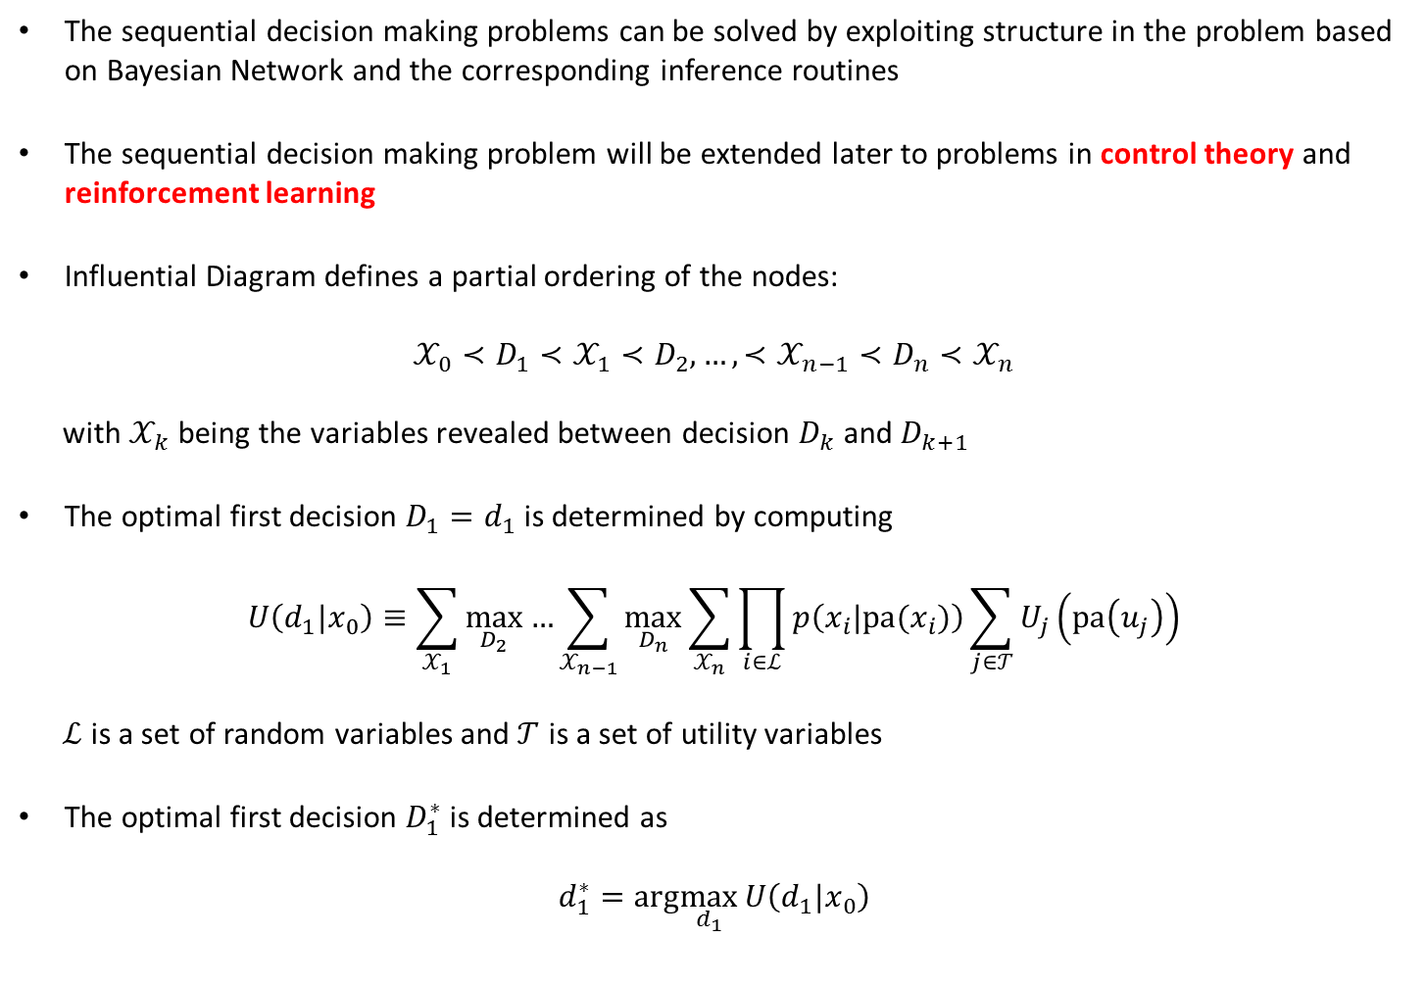
Sequential Decision Making : Partial Ordering
The sequential decision making problems can be solved by exploiting structure in the problem based on Bayesian Network and the corresponding inference routines
The sequential decision making problem will be extended later to problems in control theory and reinforcement learning
Influential Diagram defines a partial ordering of the nodes:
$$𝒳_{0}≺D_{1}≺𝒳_{1}≺D_{2},…,≺𝒳_{n−1}≺D_{n}≺𝒳_{n}$$
with $𝒳_{k}$ being the variables revealed between decision $D_{k}$ and $D_{k+1}$
The optimal first decision $D_{1}=d_{1}$ is determined by computing
$$U\left(d_{1}|x_{0}\right)≡\sum_{𝒳_{1}}^{ }{\max_{D_{2}}{…}}\sum_{𝒳_{n−1}}^{ }{\max_{D_{n}}{\sum_{𝒳_{n}}^{ }{\prod_{i∈ℒ}^{ }{p\left(x_{i}|pa(x_{i})\right)}}}}\sum_{j∈𝒯}^{ }{U_{j}\left(pa\left(u_{j}\right)\right)}$$
$ℒ$ is a set of random variables and $𝒯$ is a set of utility variables
The optimal first decision $D_{1}^{∗}$ is determined as
$$d_{1}^{∗}=arg\max_{d_{1}}{U\left(d_{1}|x_{0}\right)}$$

Slide 17
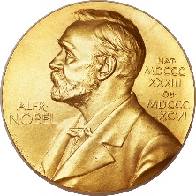


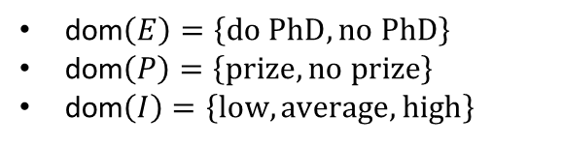



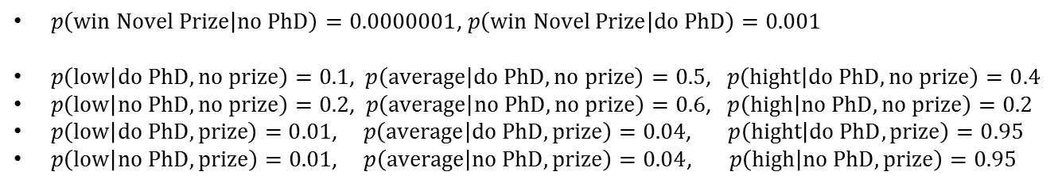


Example: Should I do a PhD?
$$E$$
$$P$$
Do PhD to wind a Novel Prize?
The ordering : $E^{∗}≺\{I, P\}$
$$I$$
Domains
$$U_{C}$$
dom$\left(E\right)=\left\{do PhD, no PhD\right\}$
dom$\left(P\right)=\left\{prize, no prize\right\}$
dom$\left(I\right)=\left\{low, average, high\right\}$
Utilities
$$U_{B}$$
$U_{C}\left(do PhD\right)=−50000, { U}_{C}\left(no PhD\right)=0$
$U_{B}\left(low\right)=100000, { U}_{B}\left(average\right)=200000, U_{B}\left(high\right)=500000$
Probabilities
$p\left(win Novel Prize | no PhD\right)=0.0000001$, $p\left(win Novel Prize | do PhD\right)=0.001$
$p\left(low | do PhD, no prize\right)=0.1$, $p\left(average | do PhD, no prize\right)=0.5$, $p\left(hight | do PhD, no prize\right)=0.4$
$p\left(low | no PhD,no prize\right)=0.2$, $p\left(average | no PhD,no prize\right)=0.6$, $p\left(high | no PhD,no prize\right)=0.2$
$p\left(low | do PhD, prize\right)=0.01$,$p\left(average | do PhD, prize\right)=0.04$, $p\left(hight | do PhD, prize\right)=0.95$
$p\left(low | no PhD,prize\right)=0.01$, $p\left(average | no PhD,prize\right)=0.04$, $p\left(high | no PhD,prize\right)=0.95$

Slide 18



Example: Should I do a PhD?
$$E$$
$$P$$
Do PhD to wind a Novel Prize?
The ordering : $E^{∗}≺\{I, P\}$
$$I$$
Domains
$$U_{C}$$
dom$\left(E\right)=\left\{do PhD, no PhD\right\}$
dom$\left(P\right)=\left\{prize, no prize\right\}$
dom$\left(I\right)=\left\{low, average, high\right\}$
Utilities
$$U_{B}$$
$U_{C}\left(do PhD\right)=−50000, { U}_{C}\left(no PhD\right)=0$
$U_{B}\left(low\right)=100000, { U}_{B}\left(average\right)=200000, U_{B}\left(high\right)=500000$
Probabilities
$p\left(win Novel Prize | no PhD\right)=0.0000001$, $p\left(win Novel Prize | do PhD\right)=0.001$
$p\left(low | do PhD, no prize\right)=0.1$, $p\left(average | do PhD, no prize\right)=0.5$, $p\left(hight | do PhD, no prize\right)=0.4$
$p\left(low | no PhD,no prize\right)=0.2$, $p\left(average | no PhD,no prize\right)=0.6$, $p\left(high | no PhD,no prize\right)=0.2$
$p\left(low | do PhD, prize\right)=0.01$,$p\left(average | do PhD, prize\right)=0.04$, $p\left(hight | do PhD, prize\right)=0.95$
$p\left(low | no PhD,prize\right)=0.01$, $p\left(average | no PhD,prize\right)=0.04$, $p\left(high | no PhD,prize\right)=0.95$
The expected utility of Education is
$$U\left(E\right)=\sum_{I, P}^{ }{p\left(I | E, P\right)p\left(P | E\right)\left[U_{C}\left(E\right)+U_{B}(I)\right]}$$
$$U\left(do PhD\right)=260174$$
$$U\left(no PhD\right)=240000$$

Slide 19

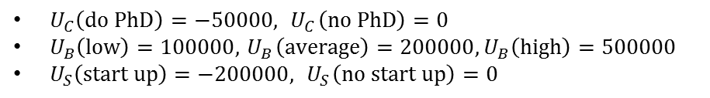
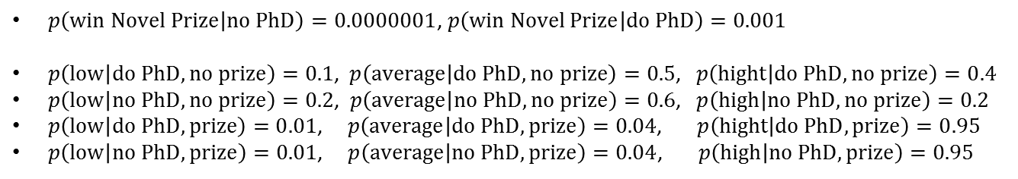
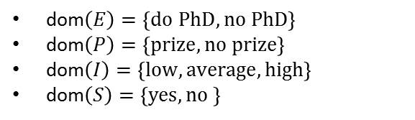



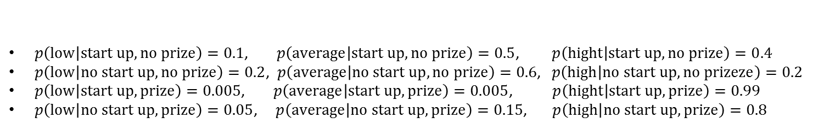
Example: PhD and start-up companies
$$E$$
$$P$$
$$S$$
Do PhD to wind a Novel Prize and start-up?
The ordering : $E^{∗}≺P≺S^{∗}≺I$
Domains
dom$\left(E\right)=\left\{do PhD, no PhD\right\}$
dom$\left(P\right)=\left\{prize, no prize\right\}$
dom$\left(I\right)=\left\{low, average, high\right\}$
dom$\left(S\right)=\left\{yes, no \right\}$
$$U_{C}$$
$$I$$
$$U_{S}$$
Utilities
$U_{C}\left(do PhD\right)=−50000, { U}_{C}\left(no PhD\right)=0$
$U_{B}\left(low\right)=100000, { U}_{B}\left(average\right)=200000,U_{B}\left(high\right)=500000$
$U_{S}\left(start up\right)=−200000, { U}_{S}\left(no start up\right)=0$
$$U_{B}$$
Probabilities
$p\left(win Novel Prize | no PhD\right)=0.0000001$, $p\left(win Novel Prize | do PhD\right)=0.001$
$p\left(low | do PhD, no prize\right)=0.1$, $p\left(average | do PhD, no prize\right)=0.5$, $p\left(hight | do PhD, no prize\right)=0.4$
$p\left(low | no PhD,no prize\right)=0.2$, $p\left(average | no PhD,no prize\right)=0.6$, $p\left(high | no PhD,no prize\right)=0.2$
$p\left(low | do PhD, prize\right)=0.01$,$p\left(average | do PhD, prize\right)=0.04$, $p\left(hight | do PhD, prize\right)=0.95$
$p\left(low | no PhD,prize\right)=0.01$, $p\left(average | no PhD,prize\right)=0.04$, $p\left(high | no PhD,prize\right)=0.95$
$p\left(low | start up, no prize\right)=0.1$, $p\left(average | start up, no prize\right)=0.5$, $p\left(hight | start up, no prize\right)=0.4$
$p\left(low | no start up,no prize\right)=0.2$, $p\left(average | no start up,no prize\right)=0.6$, $p\left(high | no start up,no prizeze\right)=0.2$
$p\left(low | start up, prize\right)=0.005$,$p\left(average | start up, prize\right)=0.005$, $p\left(hight | start up, prize\right)=0.99$
$p\left(low | no start up,prize\right)=0.05$, $p\left(average | no start up,prize\right)=0.15$, $p\left(high | no start up,prize\right)=0.8$

Slide 20



Example: PhD and start-up companies
$$E$$
$$P$$
$$S$$
Do PhD to wind a Novel Prize and start-up?
The ordering : $E^{∗}≺P≺S^{∗}≺I$
Domains
dom$\left(E\right)=\left\{do PhD, no PhD\right\}$
dom$\left(P\right)=\left\{prize, no prize\right\}$
dom$\left(I\right)=\left\{low, average, high\right\}$
dom$\left(S\right)=\left\{yes, no \right\}$
$$U_{C}$$
$$I$$
$$U_{S}$$
Utilities
$U_{C}\left(do PhD\right)=−50000, { U}_{C}\left(no PhD\right)=0$
$U_{B}\left(low\right)=100000, { U}_{B}\left(average\right)=200000,U_{B}\left(high\right)=500000$
$U_{S}\left(start up\right)=−200000, { U}_{S}\left(no start up\right)=0$
$$U_{B}$$
Our interest is to advise whether or not it is desirable to take a PhD, bearing mind that later one may or may not win the Novel Prize, and may or may not form a start-up company
The expected optimal utility for any state $E$ is
$$U\left(E\right)=\sum_{P}^{ }{\max_{S}{\sum_{I}^{ }{p\left(I | S, P\right)p\left(P | E\right)\left[U_{C}\left(E\right)+U_{B}\left(I\right)+U_{C}(S)\right]}}}$$
(where we assume that the optimal decisions are taken in the future)
$$U\left(do PhD\right)=190195$$
$$U\left(no PhD\right)=240002$$

